Slide 1
KNOWLEDGE SECURE
TEAM : 20 (CodeCrypt)

Slide 2
Motivation
There is a lot of content on the Internet on any topic which you want to learn but very little resources to test yourselves afterwards. So, to provide people with a portal where they can learn as well as test themselves on various topics related to security, we were motivated to make this portal.
The main objective of this web app is to help a person learn the concepts of Information Security and then evaluate his/her self on the same.

Slide 3
Introduction
This web application is for watching short videos on different topics related to Information and Cyber Security as well as for attempting quizzes in an efficient manner. The students can give quizzes according to their convenience and time which is a major need in today’s world.

Slide 4
Features
Since in today’s world, English has become the global language for every field. But, we should not forget that there are many people who are not so fluent in English but they too deserve an opportunity to learn concepts of Cyber Security. So, with keeping those people in mind we have also implemented Hindi as an alternate language as the choice of learning in our web application.

Slide 5
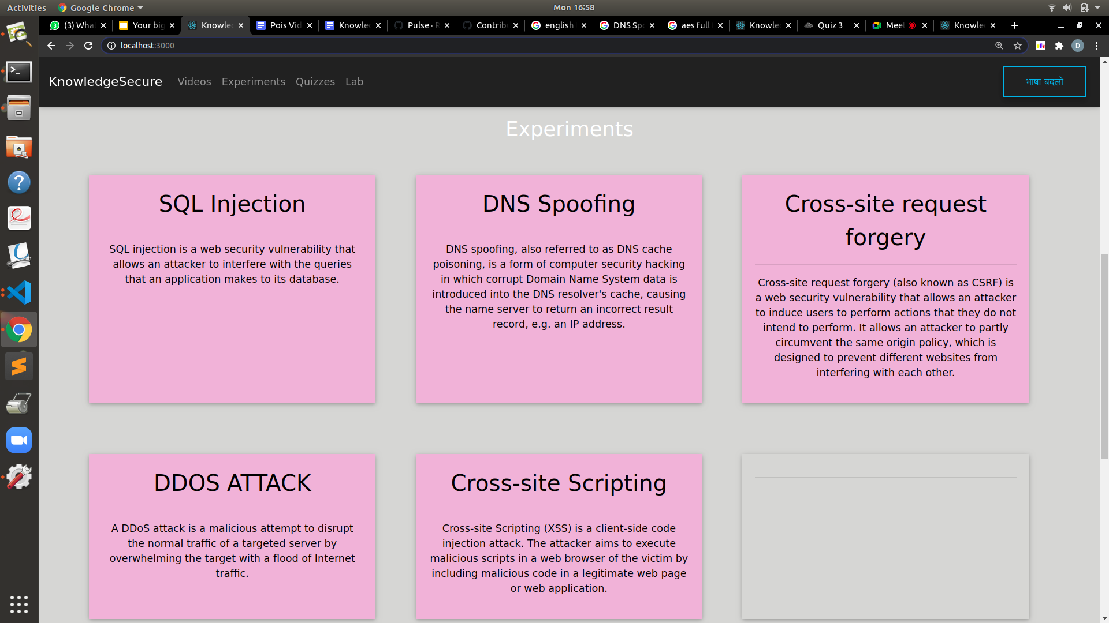
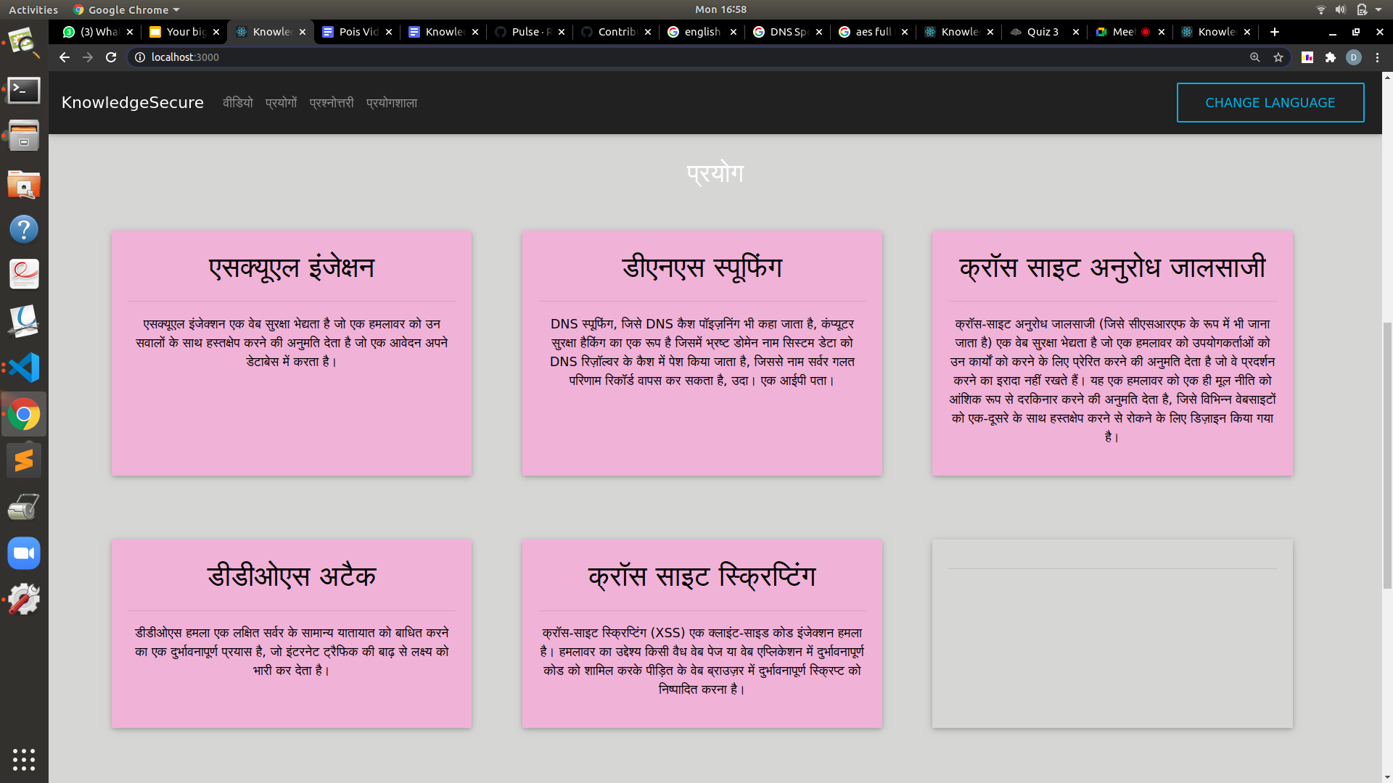
Language Compatible

Slide 6
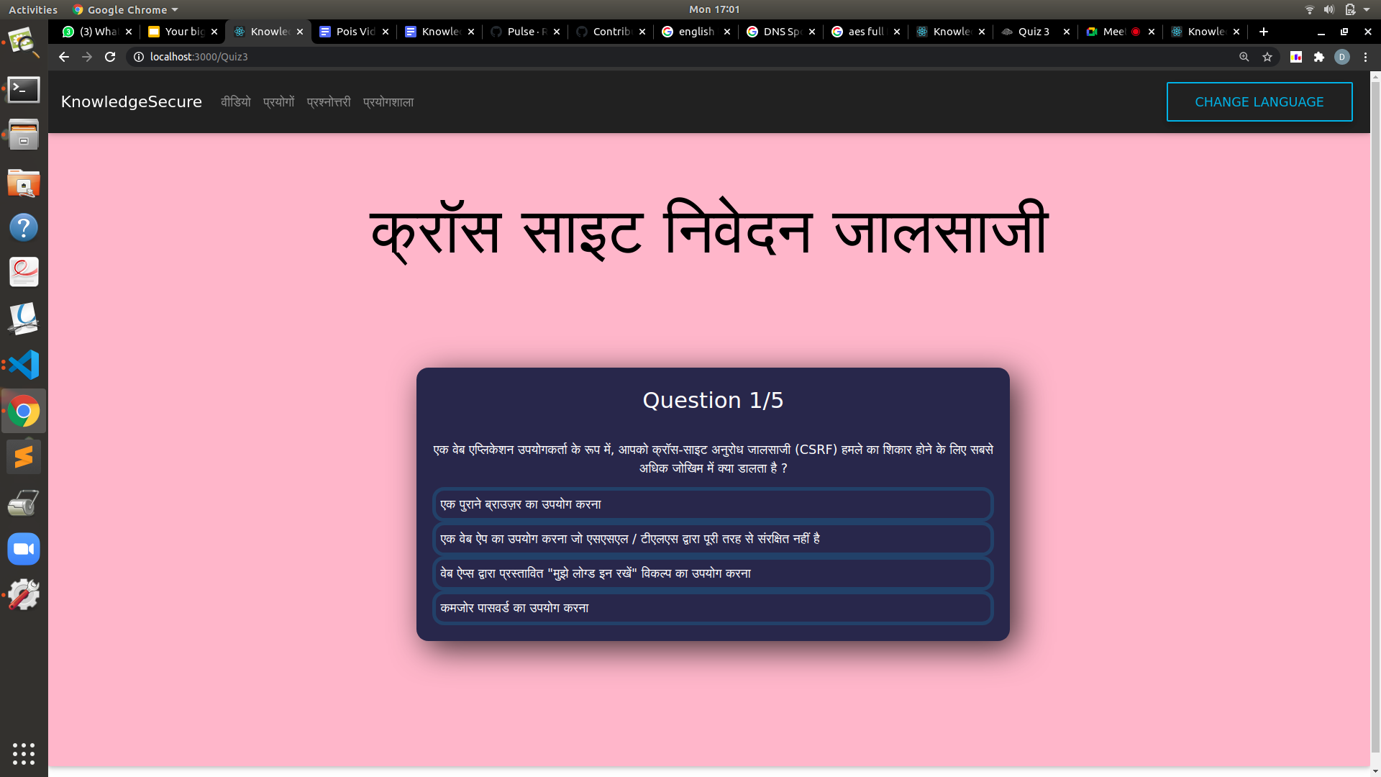
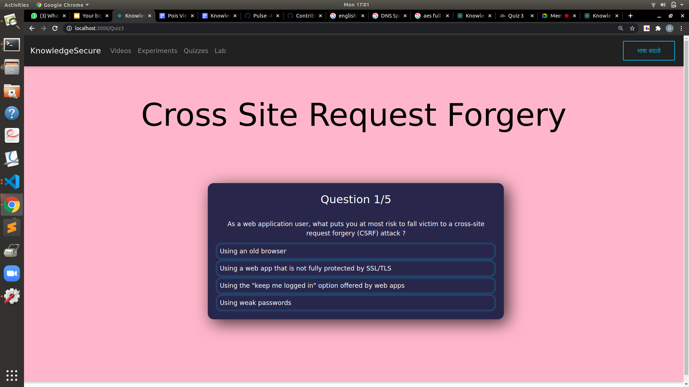
Language Compatible

Slide 7
Features
Lecture videos provided by Security Pathshala are integrated into the application so the student can learn and then test themselves on the same place.
This reduces the amount of time which students waste on hopping from place to place in search of informational videos and quiz.

Slide 8
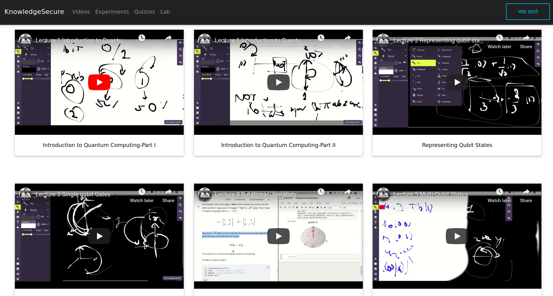
Lecture Videos
Lecture Videos have been taken from Team: Security Pathshala and have been integrated with our app.

Slide 9
Features
Short quizzes which do not take much time and can be done in 15-20 minutes. Short quiz ensures that the student doesn’t need a stable internet connection for a long time.
Topics Covered -
AES
DNS Spoofing
Cross Site Request Forgery
Perfect Secrecy
DoS Attack

Slide 10

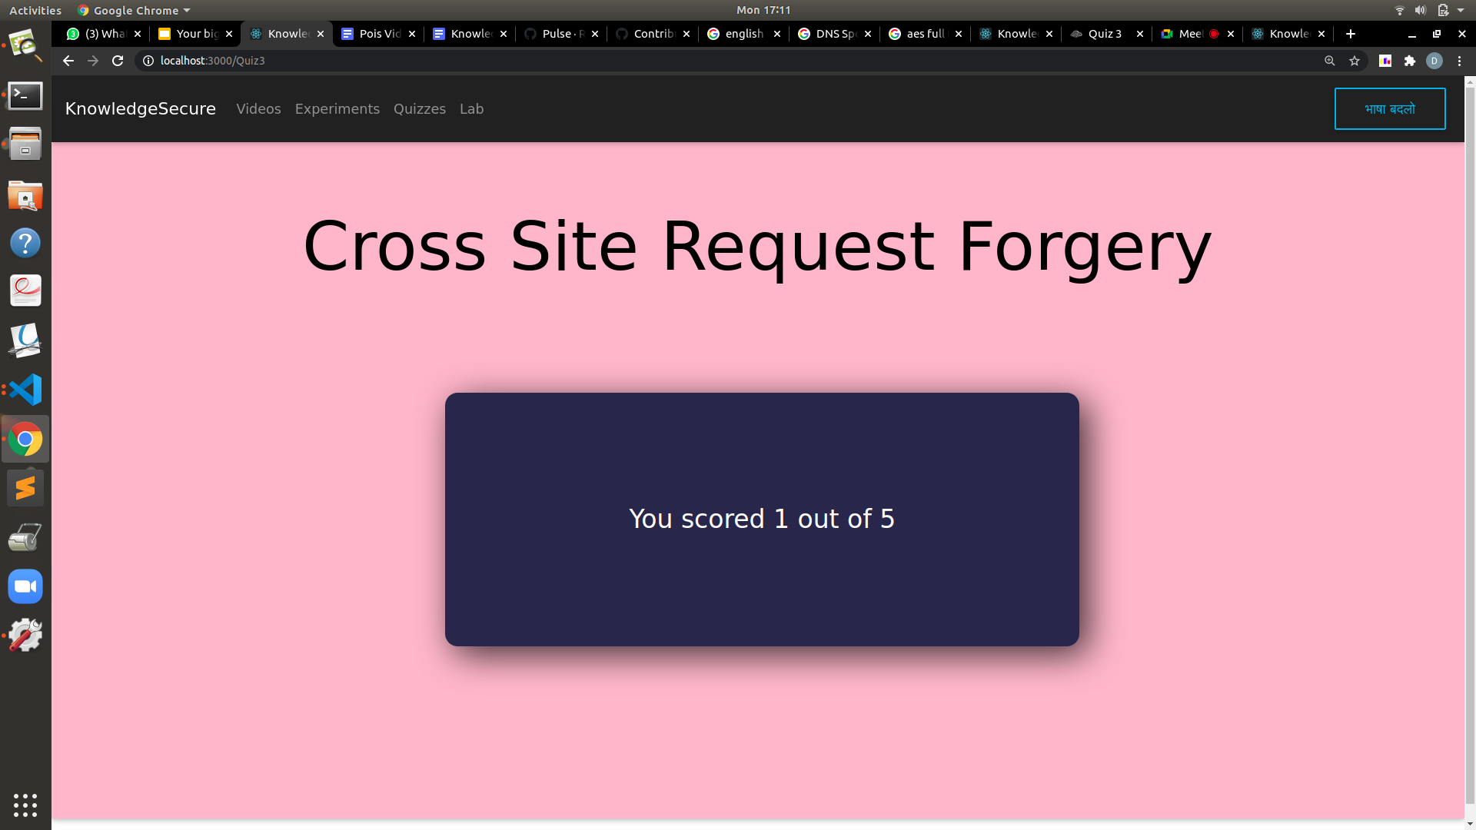
Quiz

Slide 11
Features
There are short-and-simple videos on different cyber attacks which are very common. The video explains how exactly a specific cyber attack is done. Methods to prevent these attacks are also discussed.

Slide 12
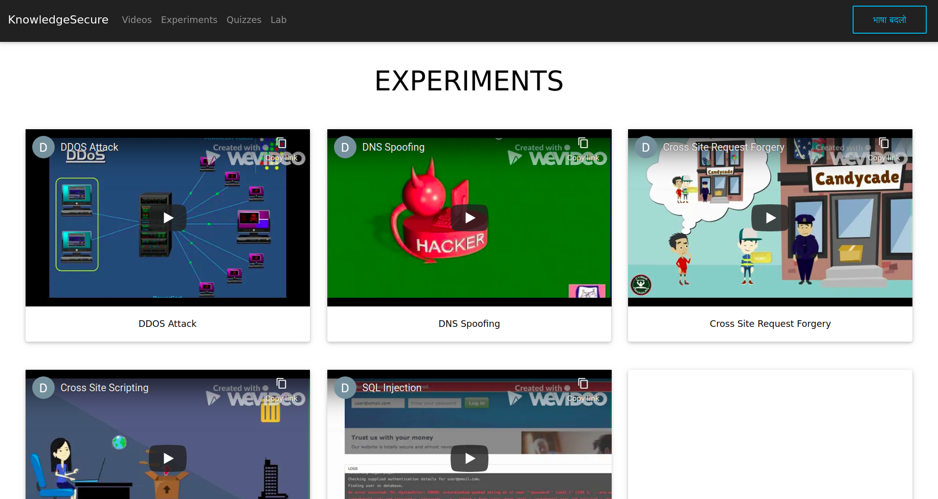
Experiments

Slide 13
Features
There is a lab (kind of :P) in our web application where you can see how things like SQL injection happen in real life and some of the simple ciphers like Caesar Cipher work.

Slide 14
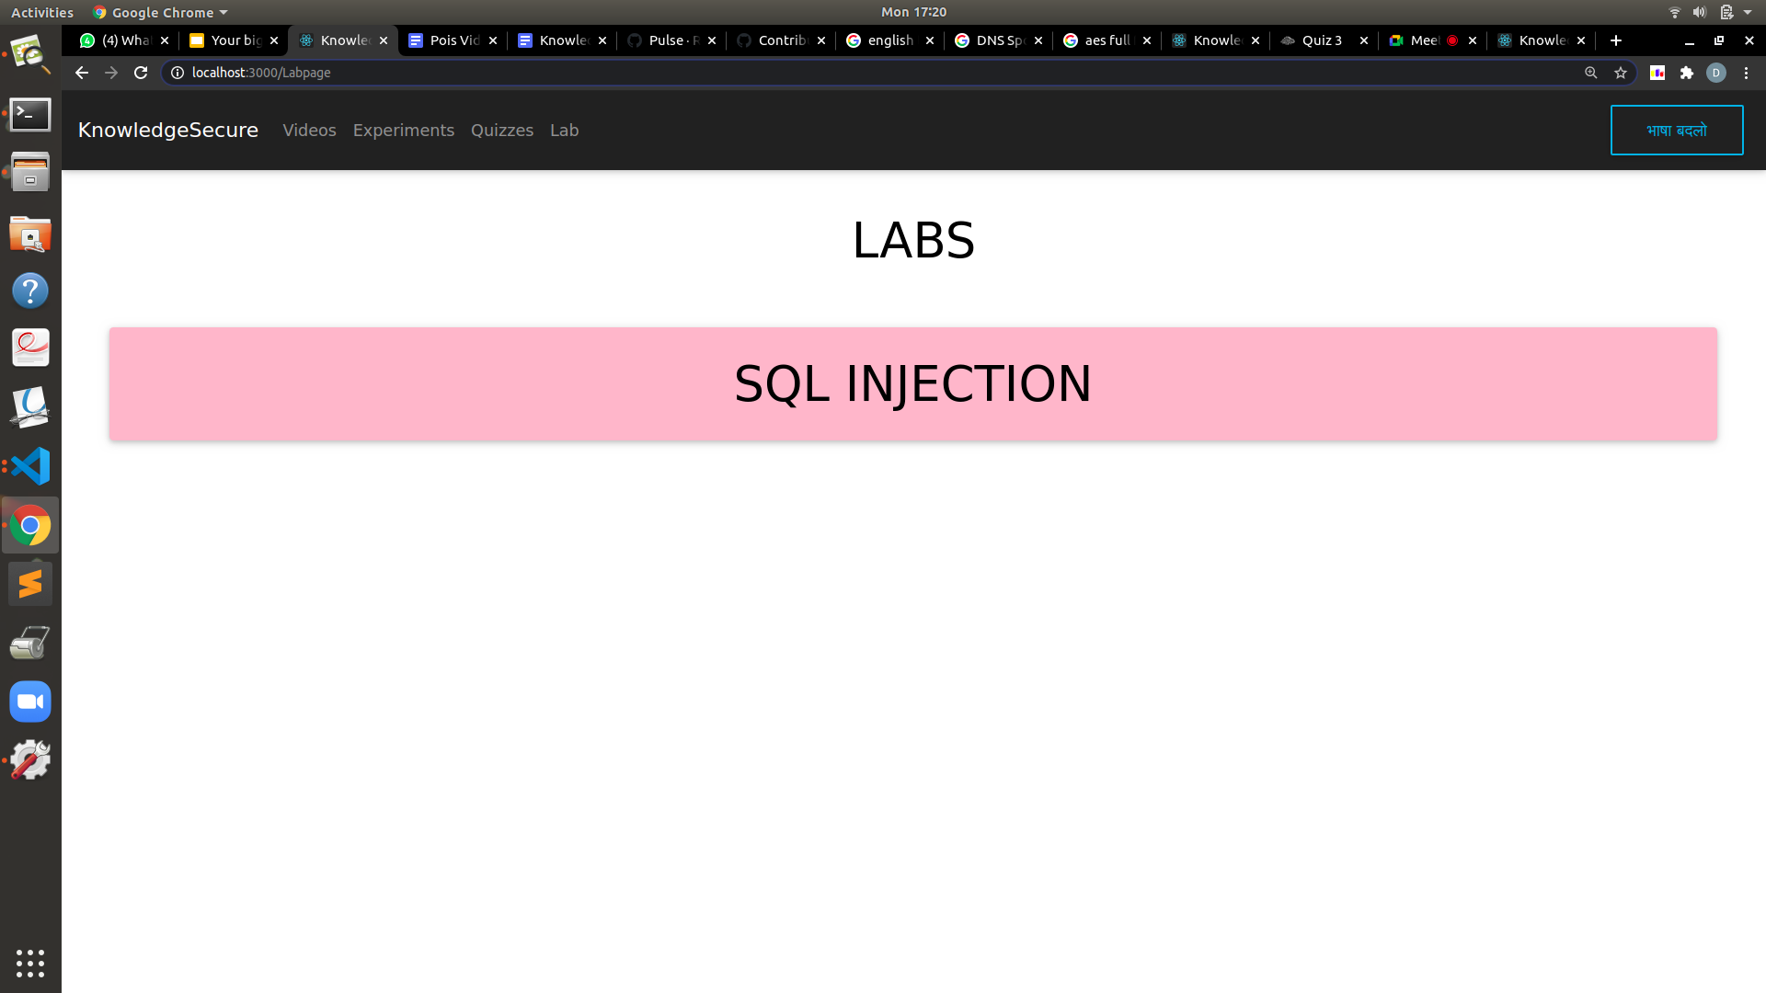
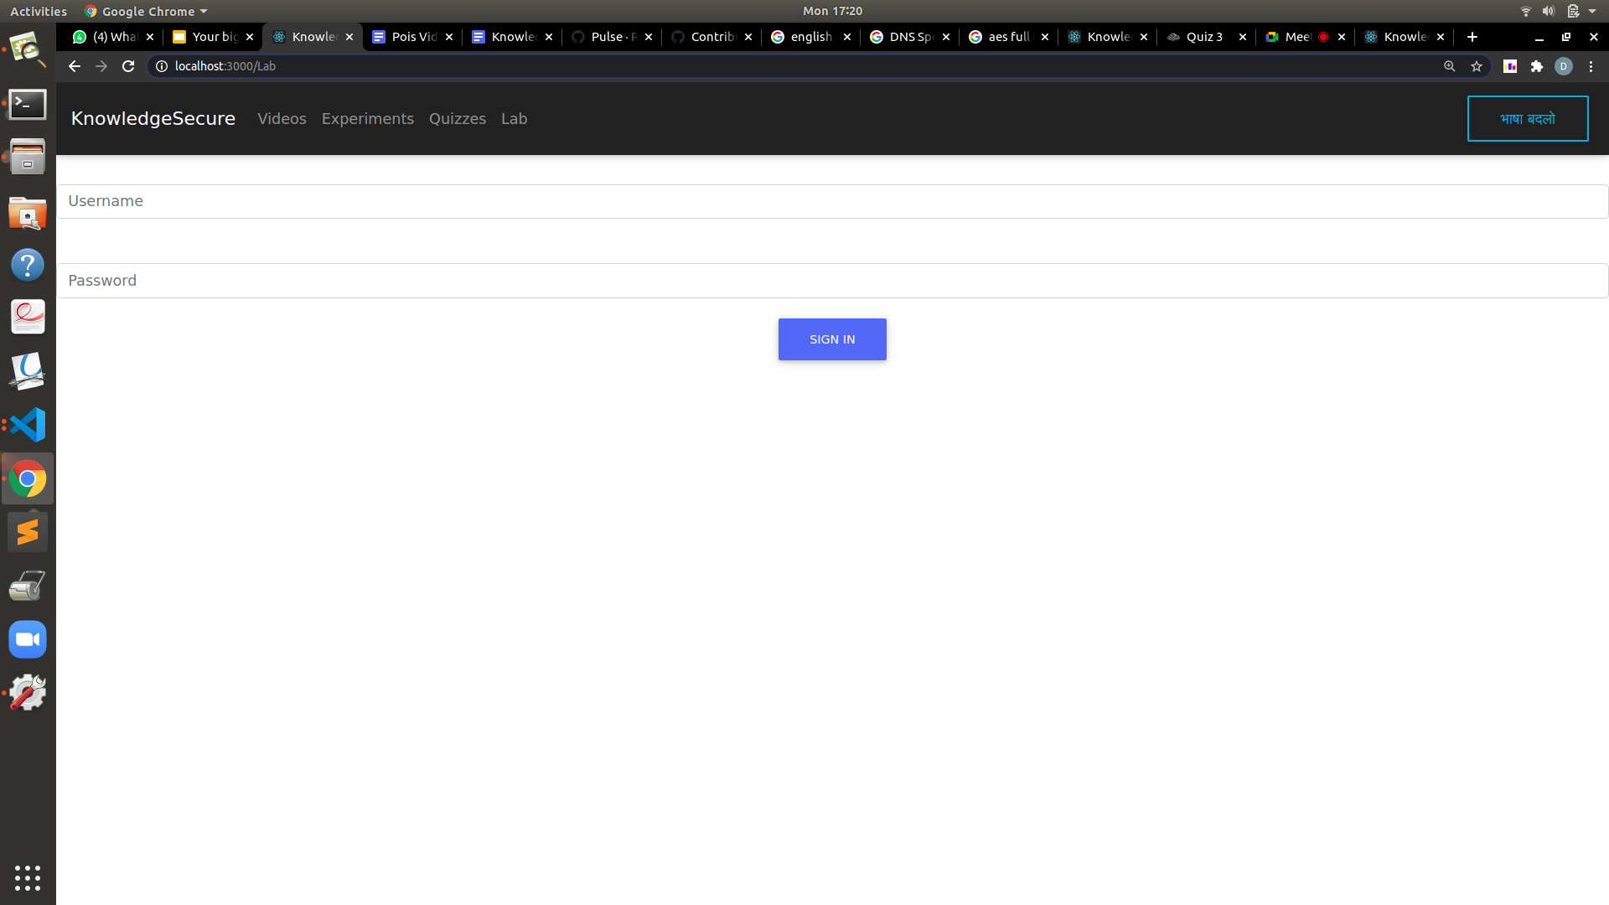
Lab

Slide 15
Features
There is a Contact Us form in the end of our application where people can mail us suggestions regarding the existing features of the application and any bug they encountered as well as request new features which they would like to see on the website.

Slide 16
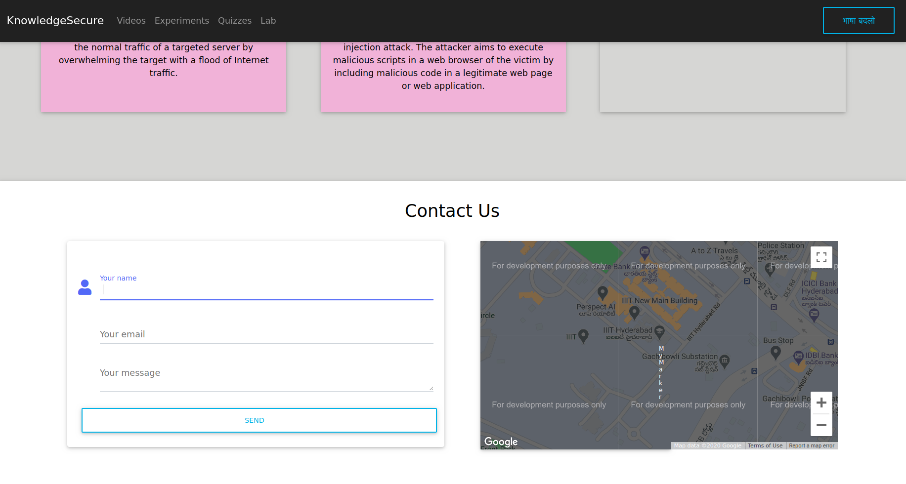
Contact Us

Slide 17
Features
The app has been deployed on Heroku to provide access to everyone. https://knowledge-secure.herokuapp.com/

Slide 18
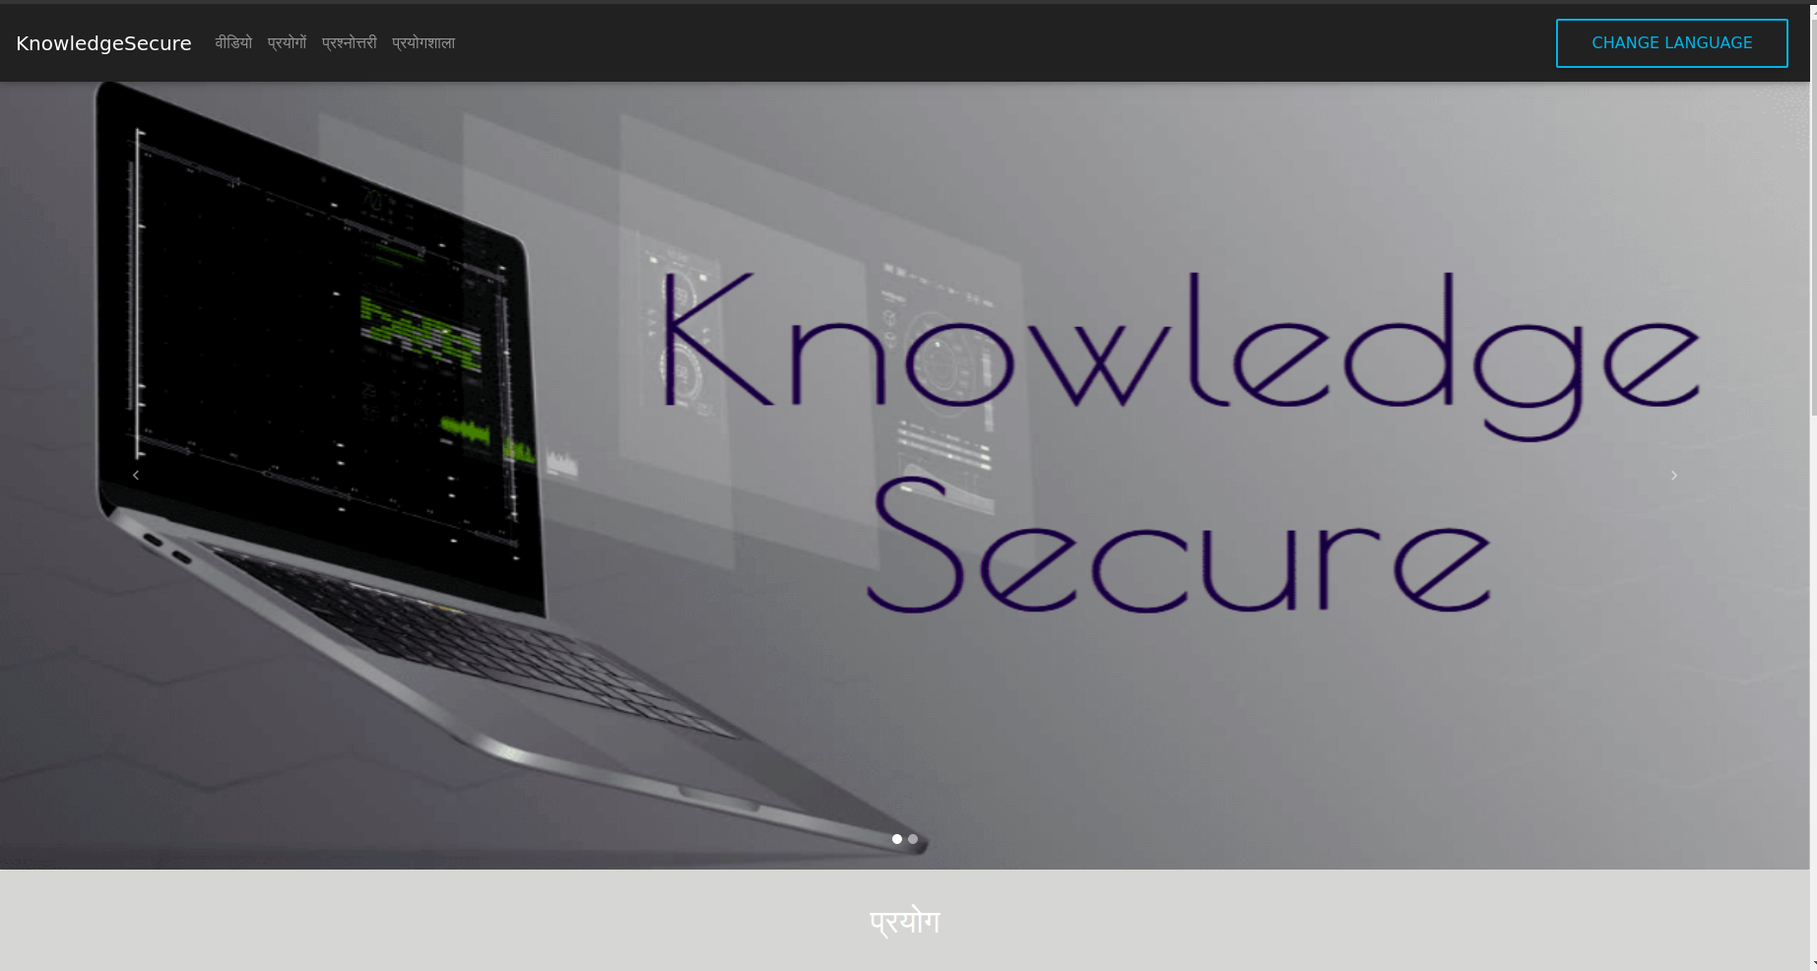
Deployment

Slide 19
Plans for the Future
Plan to include a short explanation of the answers of the quiz which is only revealed after a person submits the quiz and gets his/her score.
We plan to extend the number of languages offered in our application to 4 or 5, extending to Telugu, Tamil and Marathi, depending on the number of people who request the same.
Plan to extend the lecture videos and quizzes to more topics related Information Security.

